Slide 1
Movie recommendation system
Sprint 6

Slide 2
Sprint goals recap:
Progress on frontend: semantic search bar and movie list
Tests
Integrate Llama
API documentation

Slide 3
Changes:
Lack of knowledge, lots of researches
Lack of experience using Swagger
No integration yet

Slide 4
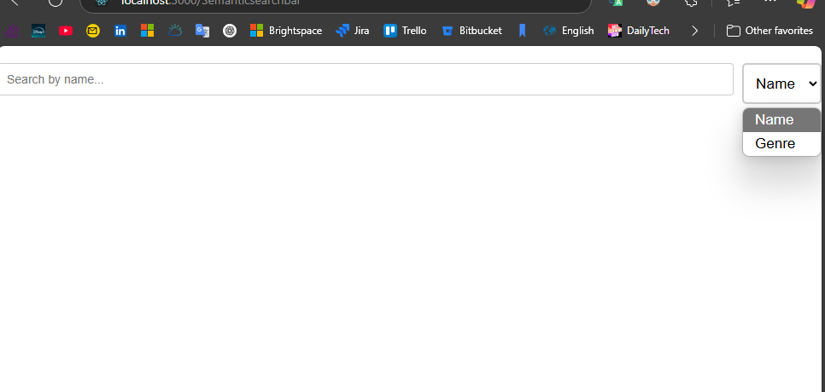
Semantic search bar component

Slide 5
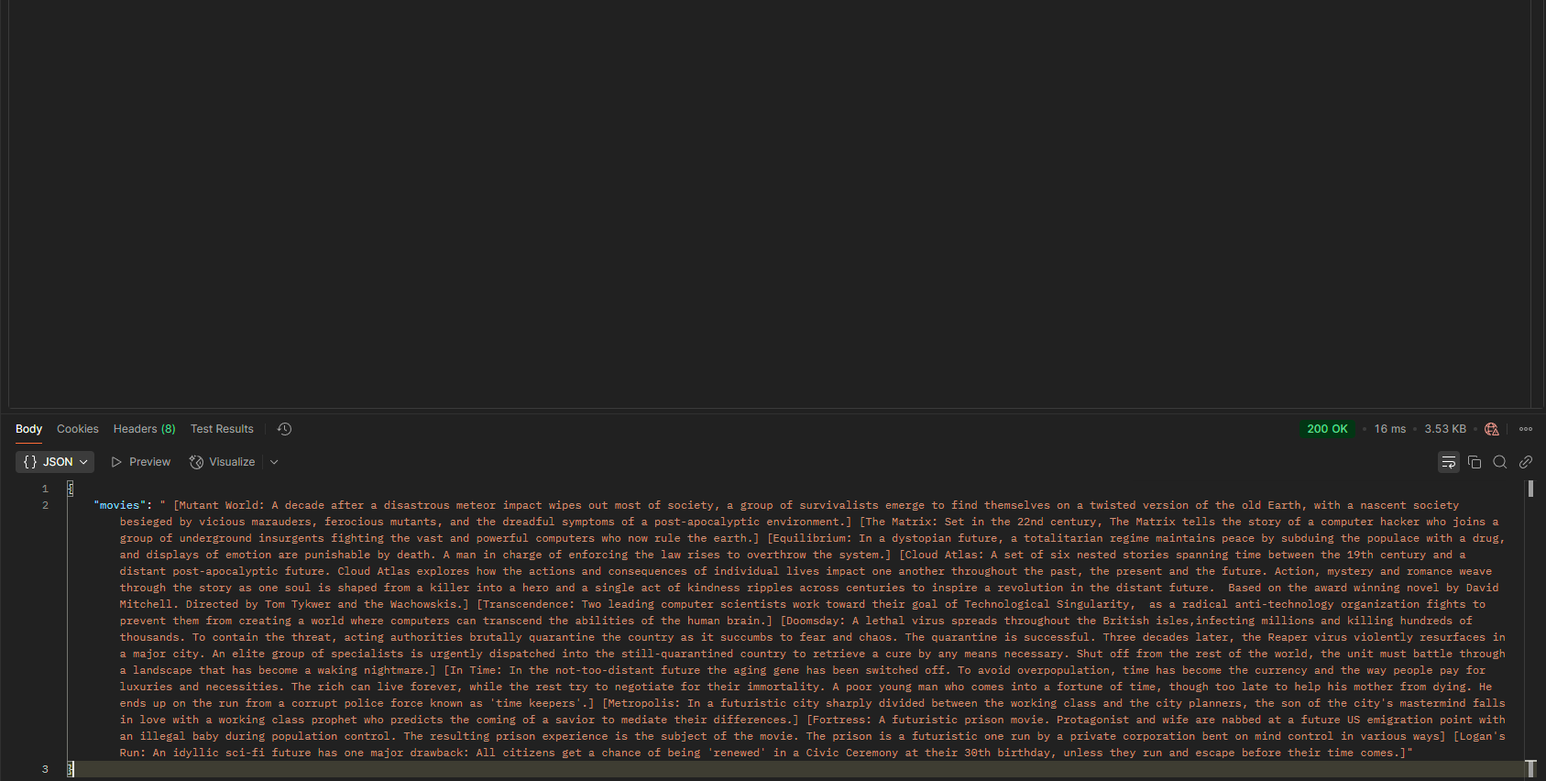
Researched vectorization
Set up LlaMa 3.2
Set up server route for recommendation API call
Integrated LlaMa

Slide 6
Thank you
Presented by:
Julia, Martin, Matthew

